Slide 1

COMPUTER NETWORKS
S Nagasundari
Department of Computer Science and Engineering

Slide 2

COMPUTER NETWORKS
Unit – 5 Link Layer and LAN Roadmap
Introduction
Error detection, correction
Multiple access protocols
LANs
Addressing, ARP
Ethernet
Switches
A day in the life of a web request
Physical layer
Purpose, Signals to Packets
Analog Vs Digital Signals
Transmission Media
Wireless LANs: IEEE 802.11

Slide 3
COMPUTER NETWORKS
Class 54 : Physical layer : Learning Objectives
Analog Vs Digital Signals
Transmission Media

Slide 4
WIRELESS NETWORK AND COMMUNICATIONS
Signal
Signal
function that conveys information
electromagnetic or electrical current that carries data from one system or network to another.
Signal may be Analog or Digital

Slide 5
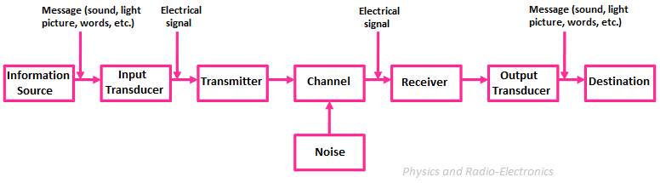
COMPUTER NETWORKS
Analog Communication System
Any information may be conveyed by an analog signal;
measured response to changes in a physical variable, such as sound, light, temperature, position, or pressure.
physical variable is converted to an analog signal by a transducer

Slide 6
COMPUTER NETWORKS
Analog Vs Digital Signals
If data is to be transmitted, then it must be transformed to electromagnetic signals.
Analog signals - infinite number of values in a range;
Digital signals can have only a limited number of values.
Data can be analog or digital.
Analog data - information that is continuous;
Analog data example: voice temperature captured by analog sensor
Digital data - information that has discrete states.

Slide 7
WIRELESS NETWORK AND COMMUNICATIONS
Digital signal
A digital signal
is a sequence of voltage pulses that may be transmitted over a copper wire medium;
for example, a constant positive voltage level may represent binary 0 and
a constant negative voltage level may represent binary 1.

Slide 8
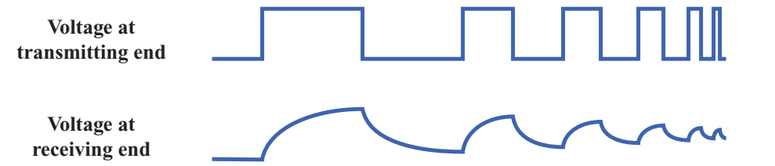
WIRELESS NETWORK AND COMMUNICATIONS
Analog and Digital signaling
The principal advantages of digital signaling
generally cheaper
less susceptible to noise interference.
The principal disadvantage is that digital signals
suffer more from attenuation than do analog signals.

Slide 9
WIRELESS NETWORK AND COMMUNICATIONS
Analog and Digital Data
Analog data
take on continuous values in some interval.
Example:
voice and video are continuously varying patterns of intensity,
Most data collected by sensors, such as temperature and pressure
Digital data take on discrete values
Examples : text and integers.

Slide 10
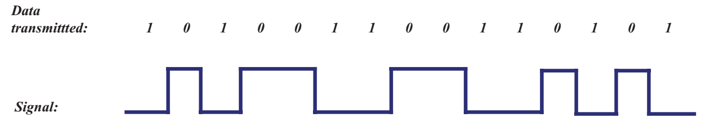
WIRELESS NETWORK AND COMMUNICATIONS
Analog and Digital Data
Data is defined as entities that convey meaning, or information.
Signals are electric or electromagnetic representations of data.
Transmission is the communication of data by the propagation and processing of signals.

Slide 11
COMPUTER NETWORKS
Transmission Media
Transmission medium-the physical path between transmitter and receiver.
Repeaters or amplifiers may be used to extend the length of the medium.
Communication of electromagnetic waves is guided or unguided.
Guided media : waves are guided along a physical path (e.g, twisted pair, coaxial cable and optical fiber).
Unguided media: means for transmitting but not guiding electromagnetic waves (e.g., the atmosphere and outer space).

Slide 12
COMPUTER NETWORKS
Types of Physical Transmission Media
Twisted pair
Coaxial cable
Optical fiber
Wireless communications

Slide 13
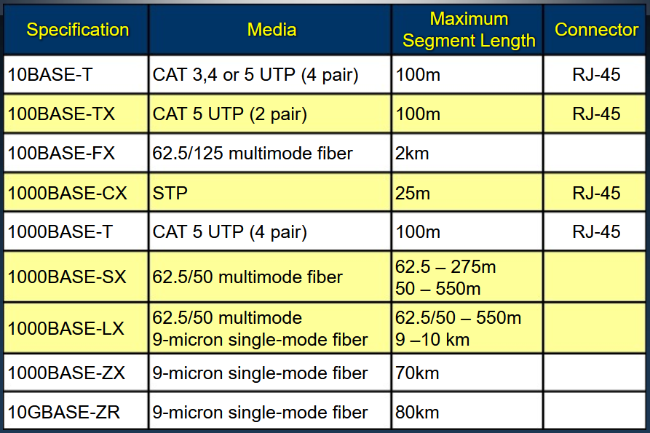
COMPUTER NETWORKS
Types of Physical Transmission Media

Slide 14
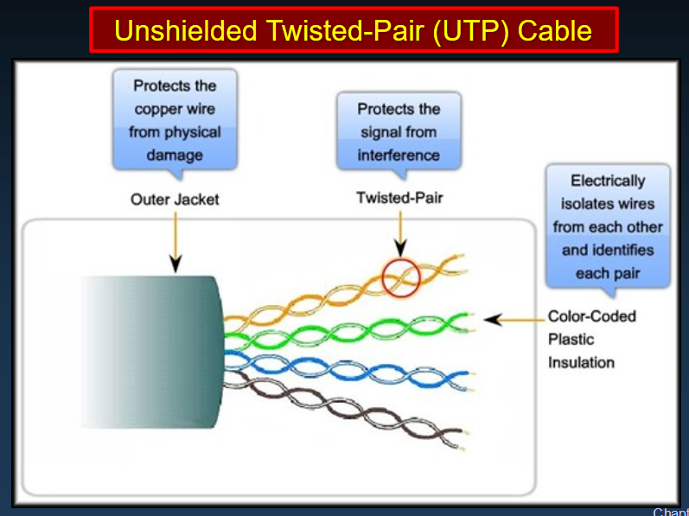
COMPUTER NETWORKS
Copper Media

Slide 15
COMPUTER NETWORKS
Copper Media
The colored pairs identify the wires for proper connection at the terminals.
There are several categories of UTP cable. Each category indicates a level of bandwidth performance as defined by the IEEE.
Category 3 (Cat 3) to Category 5 (Cat 5), 100-megabit transmissions.
In 1999, Cat 5e, full-duplex Fast Ethernet gigabit
In 2002, Category 6 (Cat 6). Allow higher performance and less crosstalk.

Slide 16
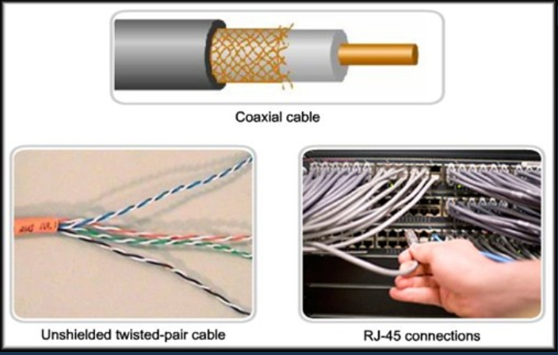
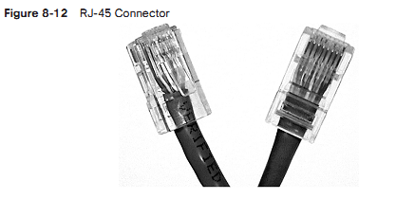
COMPUTER NETWORKS
Copper Media

Slide 17
COMPUTER NETWORKS
Optical fiber
(a) Geometry of optical fiber
light
cladding
jacket
core
(b) Reflection in optical fiber
θ_{c}

Slide 18
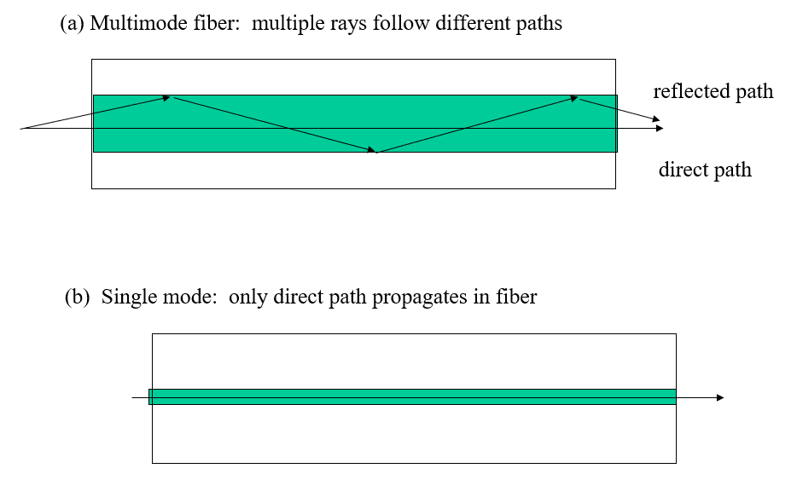
COMPUTER NETWORKS
Optical fiber

Slide 19
COMPUTER NETWORKS
Optical fiber
Three techniques
1. Multimode step-index
light propagates in the shape of a zigzag along the fiber/core axis according to the principle of total reflection.
Light entering the fiber at different angles of incidence will go through different paths.
Distance: few kms
2. Multimode graded-index
light travels forward in the form of sinusoidal oscillation.
Like step-index multimode fibers, different lights in a graded-index multimode fiber travel along different paths
Distance: 10-12 kms
Better performance

Slide 20
COMPUTER NETWORKS
Optical fiber
3. Single-mode step-index
propagation of only one traverse electromagnetic mode
core diameter must be of the order of 2 µm to 10µm.
high information carrying capacity.
Presence of multiple paths ➔ differences in delay ➔ optical rays interfere with each other.
A narrow core can create a single direct path which yields higher speeds.
WDM (Wavelength Division Multiplexing) yields more available capacity.

Slide 21
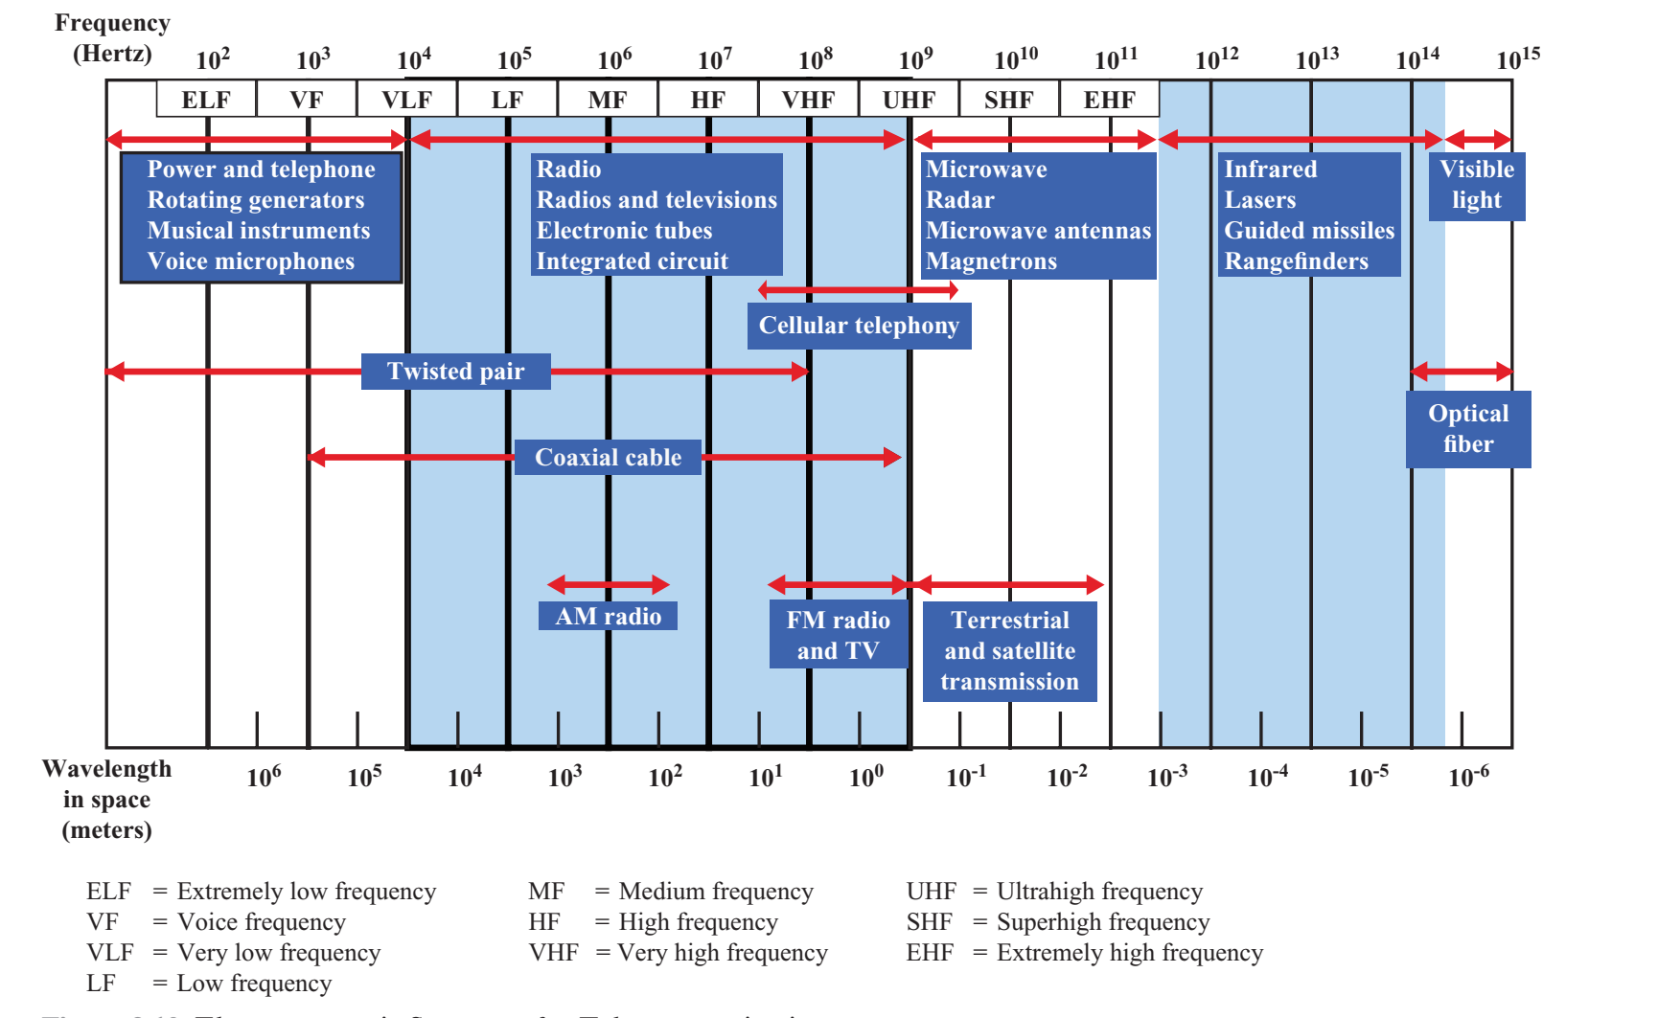
COMPUTER NETWORKS
Electromagnetic Spectrum

Slide 22
THANK YOU
S Nagasundari
Department of Computer Science and Engineering
nagasundaris@pes.edu

